Slide 1

Exploratory Data Analysis
G2M insight for Cab Investment firm
04/20/2024

Slide 2

Agenda
Executive Summary
Problem Statement
Approach
EDA and Hypothesis
Key Recommendations

Slide 3
Executive Summary
XYZ, a private firm based in the United States, plans to enter the cab industry, which has shown significant growth in recent years with multiple key players. To support its Go-to-Market (G2M) strategy, the firm seeks to understand the market dynamics before committing to an investment. The objective is to generate actionable insights to guide XYZ's investment in the most promising cab company.
Problem Statement
To help XYZ make an informed investment decision, the analysis focuses on data from two cab companies using various datasets. The goal is to identify significant insights, trends, and patterns that could inform recommendations for the optimal investment choice. The analysis examines customer profiles, transaction data, and city demographics to offer a comprehensive perspective on the cab industry. The results will be presented to XYZ's Executive team, emphasizing the quality of the analysis, the value of the recommendations, and the clarity of the visuals.

Slide 4
Approach
To examine cab usage trends and customer behavior, the following steps were taken:
Data Collection and Merging: Four datasets were used covering cab transactions, customer demographics, and city data. These were merged to create a comprehensive dataset.
Exploratory Data Analysis (EDA): Key insights were derived through visualizations such as bar charts and line plots to identify patterns and relationships.
Hypothesis Testing: Hypotheses were developed and tested to explore factors influencing cab usage, including seasonality, company preference, demographics, travel distance, and cost-to-price ratio.

Slide 5
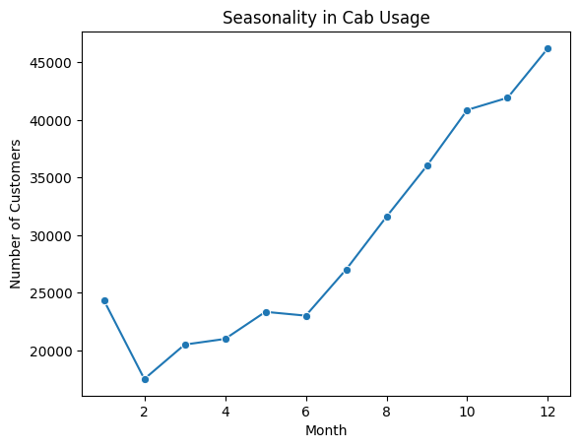
Seasonality in Cab Usage
The overall upward trend suggests cab services become more popular as the year progresses, possibly due to factors like weather, holidays, or events.
The drop from January to February could be a seasonal dip due to post-holiday trends or weather conditions.
The sharp increase from July onward indicates that cab usage is heavily influenced by events and holidays in the latter part of the year.

Slide 6
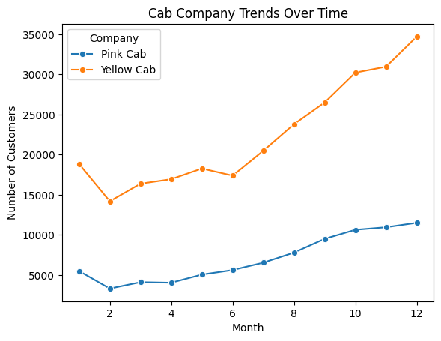
Cab Company Preference
The strong growth trend for Yellow Cab suggests an increasing preference among customers. This may be due to marketing efforts, service quality, or customer loyalty.
Pink Cab's slower growth indicates consistent but less dramatic customer acquisition. This could mean a smaller market presence or a lack of aggressive growth strategies.
The divergent trends highlight that Yellow Cab has captured more customers over the year, suggesting effective business strategies or customer satisfaction.

Slide 7
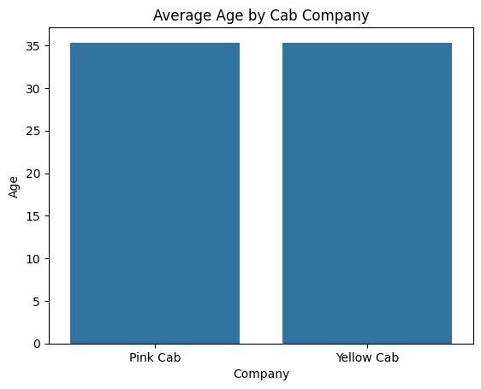
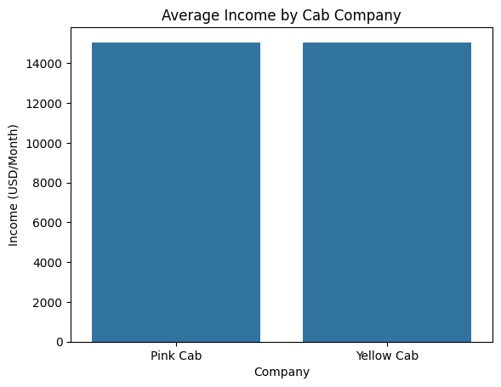
Customer Demographics
This similarity suggests that both cab companies attract customers with comparable age profiles. The lack of significant difference might indicate that age isn't a major factor influencing customer preference between these two companies.
This similarity in average income suggests that customers from similar income brackets use both cab companies. It implies that income might not be a significant factor in choosing between Pink Cab and Yellow Cab.

Slide 8
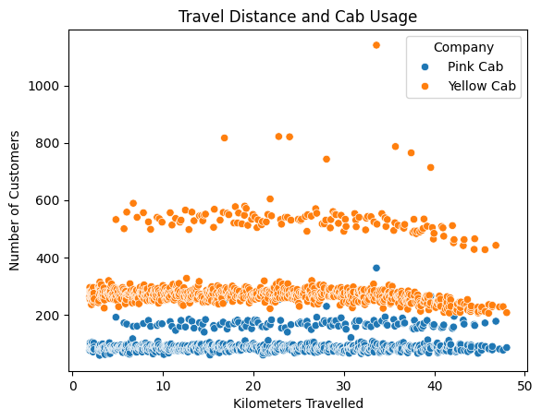
Cab Usage and Travel Distance
Yellow Cab tends to attract more customers over a broader range of travel distances, suggesting it has a more flexible or appealing service for longer trips.
Pink Cab's lower customer counts across different distances might indicate a focus on shorter trips or reduced competitiveness in longer-distance markets.
The scatter plot shows that both companies serve a range of trip lengths, with Yellow Cab generally attracting more customers, especially for longer distances.

Slide 9
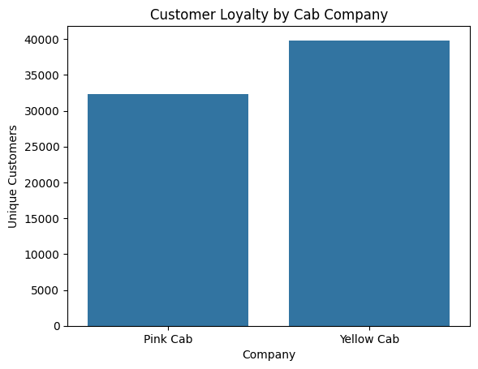
Customer Loyalty
A higher number of unique customers can suggest that a company has better customer loyalty or attracts more repeat customers.
Yellow Cab's larger base of unique customers might reflect a broader market presence, more appealing services, or stronger customer retention strategies.
Pink Cab's relatively smaller base could indicate a need for improved marketing or loyalty programs to increase customer retention and loyalty.

Slide 10
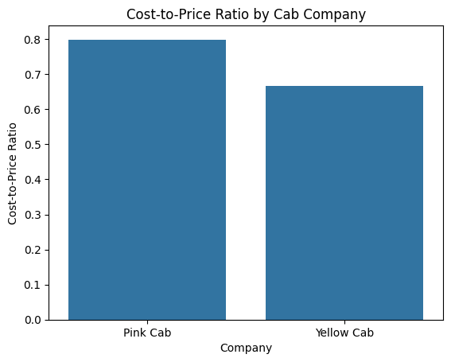
Cost-Efficiency Analysis
A lower cost-to-price ratio indicates higher cost-efficiency, as it suggests that the cab company can generate a higher margin from its trips.
In this comparison, Yellow Cab seems more cost-efficient than Pink Cab, potentially leading to higher profitability.
Pink Cab's higher cost-to-price ratio could imply that it's spending more on trip costs or is less efficient in its operations.

Slide 11
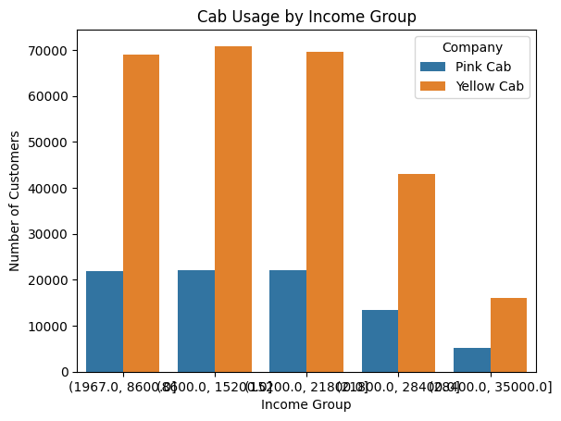
Impact of Income on Cab Usage
Yellow Cab appears to have a broader customer base across income groups, suggesting a wider appeal.
Pink Cab's customer count remains relatively stable across income groups, indicating a consistent customer base.
The noticeable drop in Yellow Cab's customer count in the highest income group might suggest that this segment has different preferences, or that Yellow Cab's offerings might not align with the expectations of higher-income customers.

Slide 12
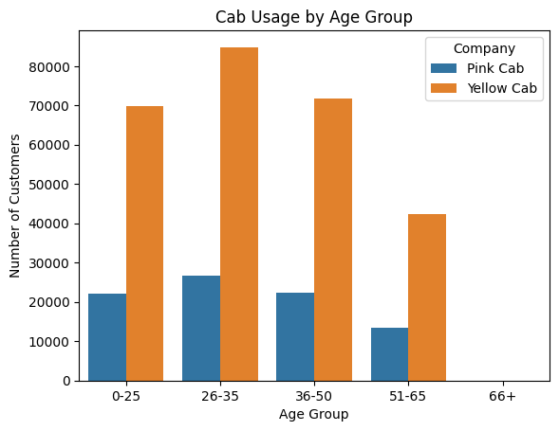
Impact of Age on Cab Usage
Yellow Cab generally has a larger customer base across all age groups, particularly in the 26-35 and 36-50 age ranges.
Pink Cab has a smaller market share in each age group, suggesting potential areas for improvement in marketing or service targeting these segments.
The drop in customers among the older age groups might indicate that these groups have different transportation preferences or lesser cab usage in general.

Slide 13
Key Recommendations
1. Seasonal Campaigns
Align marketing efforts with the seasonal trend in cab usage, focusing on high-demand months (July to December). Consider promotions, events, and partnerships to capitalize on these periods.
2. Emulate Successful Practices
Adopt cost-efficiency strategies from Yellow Cab to improve the cost-to-price ratio. Study Yellow Cab's customer service approaches for best practices.
3. Enhance Customer Retention
Introduce loyalty programs or incentives to improve Pink Cab's customer retention. Expand marketing efforts to reach new demographics.

Slide 14
Key Recommendations
4. Address Customer Demographics
Offer personalized services or promotions to cater to different age groups and income levels. Develop targeted marketing campaigns for specific demographics.
5. Optimize Resource Planning
Adjust staffing levels and resources to align with seasonal fluctuations. Implement flexible pricing strategies to maintain business during off-peak periods.
6. Target Longer Travel Distances
Offer special rates or packages to attract customers for longer trips. Expand service areas and provide additional amenities for longer travel.

Slide 15
a
Thank You

